Slide 1
Theory of Elasticity in Geotechnical Engineering
Lecture
Hadush Seged (Dr.)
November 17, 2009

Slide 2
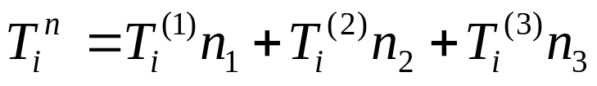
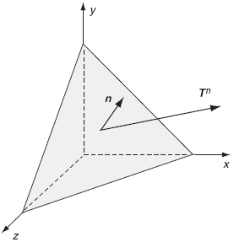
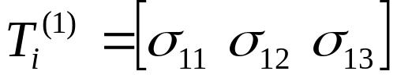
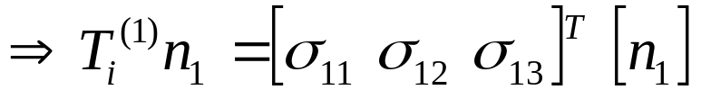
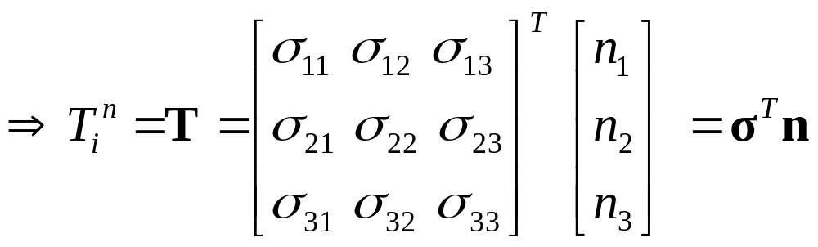
Analysis of Stress in 3D (continued)
Previously we discussed that:
The traction (or stress) vector T at a point:
,etc…
,etc…

Slide 3
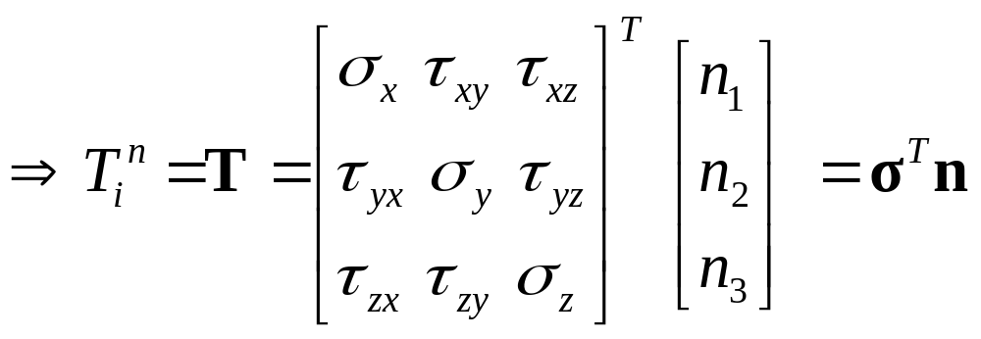

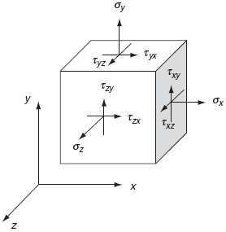



























…...(2.1)
Cauchy’s formula
Stress notations:

Slide 4
The stress tensor (or matrix) σ is very important and contains all the information needed to find the traction on every surface that passes through the point in question.
By knowing the nine components of σ (where only six are independent) we can completely determine the infinitely many tractions that act on the infinitude of surfaces passing through any point.
Cauchy’s discovery created long jam of ideas in mechanics. Before, researchers had continually struggled with the description of stress.

Slide 5
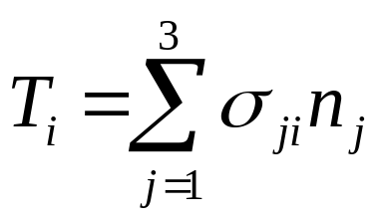
Index notation and Summation convention
From the consideration of equilibrium of forces acting on arbitrary small volume of material, the components of the stress vector T_{i} in the x-coordinate direction can be written as:
…...(2.2)
Since the subscript i is unspecified, equation (2.2) holds for each of the three possible values corresponding to x, y, z coordinates. Index i is therefore called free index.
However, index j is called a dummy index because the particular letter used in this subscript is not important.

Slide 6
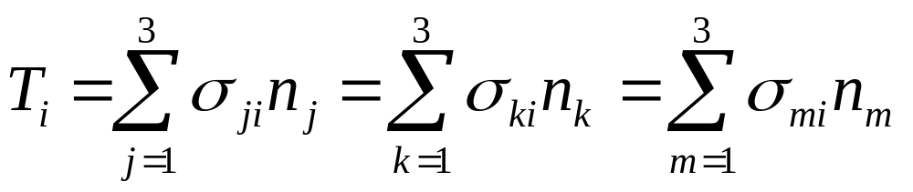
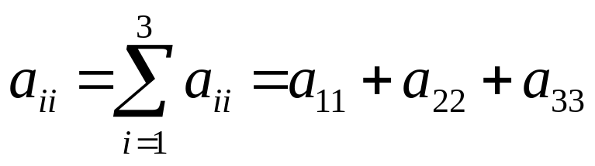
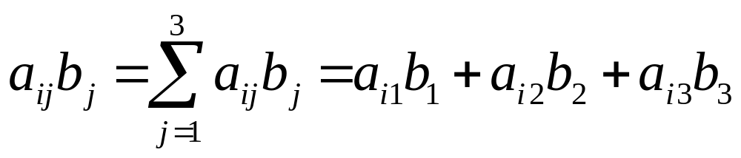
Thus:
…...(2.3)
Summation Convention:
When a subscript appears twice in the same term then summation over that subscript from 1 to 3 is implied.
For example:

Slide 7
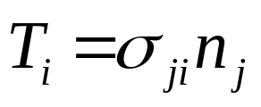
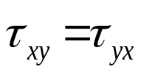

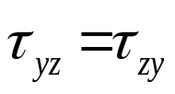
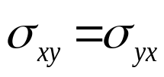

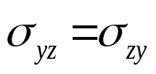



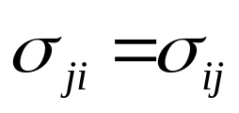
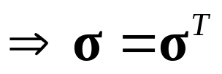
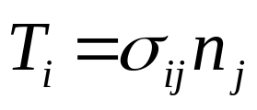
Equation (2.3) can be abbreviated as:
…...(2.4)
From the moment equilibrium of an element:
…...(2.5)
The stress tensor σ_{ij} is hence symmetric.
Equation (2.4) can be re-written more conveniently and conventionally as:
…...(2.6)

Slide 8
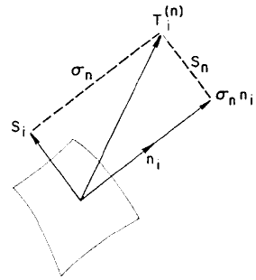
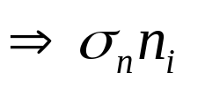
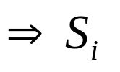
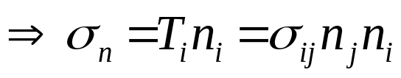
Normal and Shear Stress Components
x₃
The stress vector T_{i}^{n} acting on the surface area element at a point can be resolved into normal stress and shear stress components.
x₂
x₁
Normal stress:
Shear stress:
The magnitude of the normal stress is clearly T_{i}n_{i}.
Surface element
Components of traction normal and tangential to the surface
…...(2.7)

Slide 9
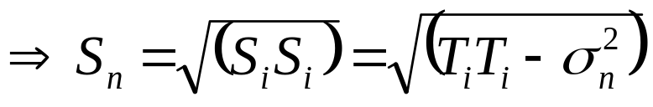
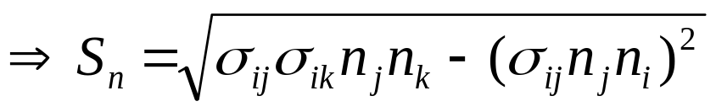
The magnitude of the shear stress is given by:
…...(2.8)
Using equations (2.6) and (2.7), equation (2.8) becomes:
…...(2.9)
Equations (2.7) and (2.9) are used to determine the normal and shear stress components of a traction vector T_{i} acting on plane n_{i}.
Equations (1.3), (2.7) and (2.9) are all called Cauchy’s equations.

Slide 10
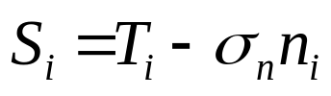
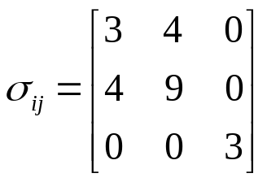

The vector σ_{n}n_{i} is in the direction of the normal vector n_{i}, and the vector S_{i}, lies in the plane formed by the two vectors T_{i} and n_{i}, or
…...(2.10)
Example 2
The state of stress at a point is represented by the given stress tensor:
For a plane with unit normal n_{i} = , calculate the normal and shear stress components.

Slide 11
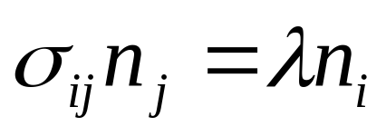
Principal Axes and Stresses
For any general state of stress at any point P in a body, there exist three mutually perpendicular planes at point P on which the shear stresses vanish. The normal stress components on these three planes are called principal stresses. The corresponding three planes are called principal planes.
This condition implies that the stress (traction) vector T_{i} is perpendicular to the area element and is parallel to the area normal n_{i,} that is T_{i} = λn_{i}, where λ is a scalar. Or using equation (2.6):
…...(2.11)

Slide 12
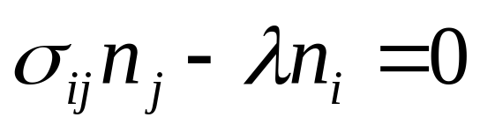
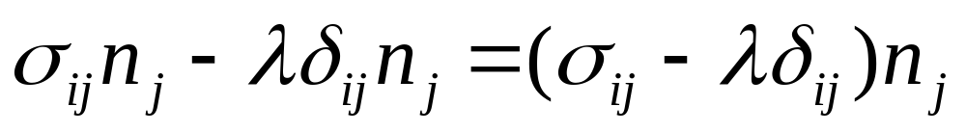
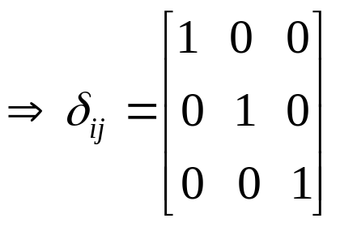
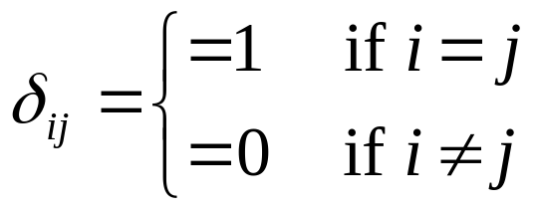
Which can be written as:
…...(2.12)
Noting that i and j are dummy indexes equation (2.12) can be re-written as:
…...(2.13)
Where δ_{ij} is called the Kronecker delta.
…...(2.14)

Slide 13
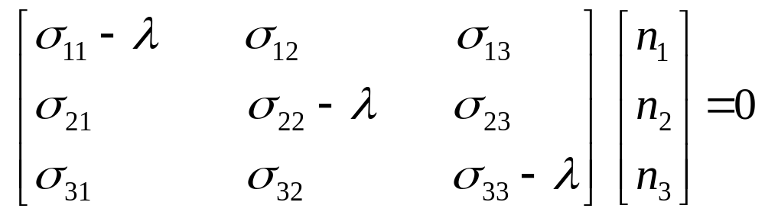
Equation (2.13) can be written in the expanded matrix form as:
…...(2.15)
It should be noted that the following relation holds for the unit normal n_{i}, and its components n₁, n₂, and n₃ which are also called direction cosines:
…...(2.16)

Slide 14










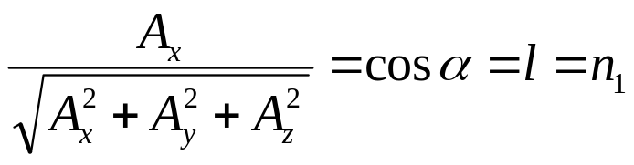
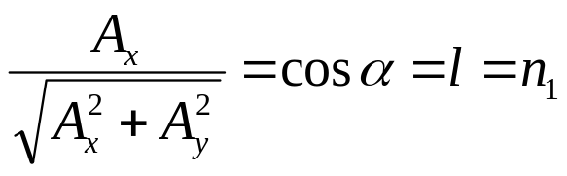
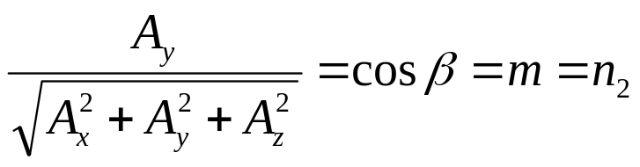
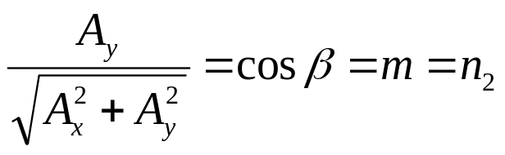
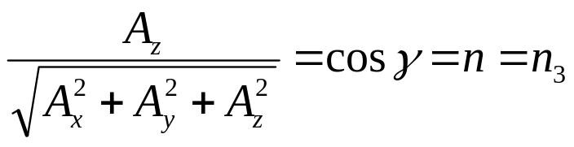
Direction Cosines
3D
2D

Slide 15
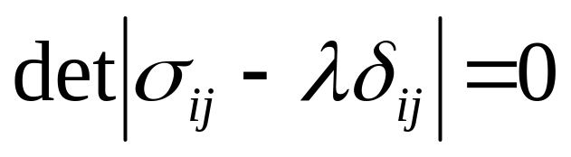
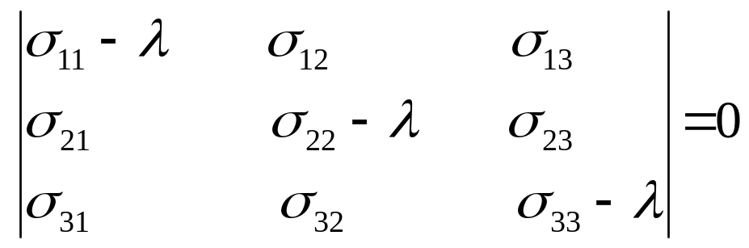
Since equation (2.16) has to be satisfied, all three components n₁, n₂, and n₃ can not be zero.
Therefore, equation (2.15) possesses solution if and only if the determinant of the coefficient matrix is zero.
…...(2.17)
or:
…...(2.18)

Slide 16
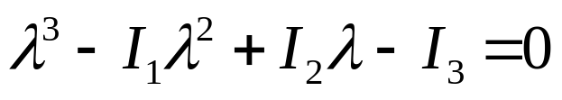
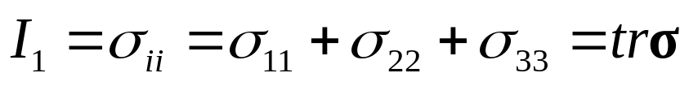
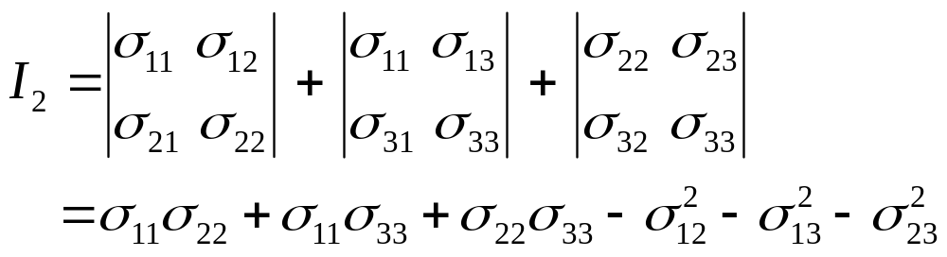
Expanding equation (2.17) leads to the following cubic equation, which is known as the characteristic equation :
…...(2.18)
where,
…...(2.19)
…...(2.20)

Slide 17
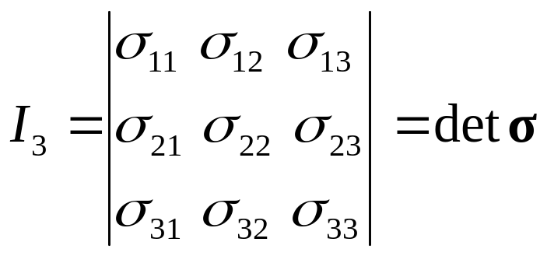

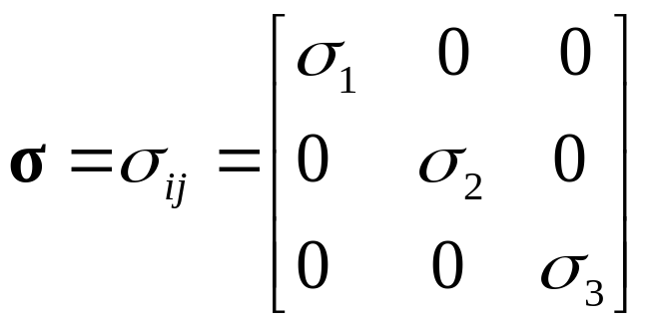
…...(2.21)
Equation (2.18) has three real roots. These three values are the three principal stresses
If the coordinate system aligns with the principal directions, the stress tensor takes the form:
…...(2.22)

Slide 18
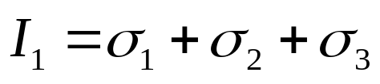
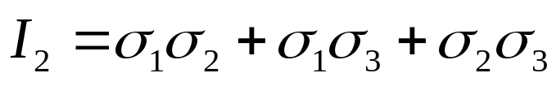
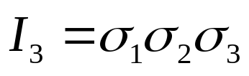
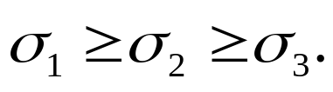
in which,
…...(2.23)
…...(2.24)
…...(2.25)
the largest principal stress is called major principal stress, and the smallest minor principal stress. The other value is called intermediate principal stress. Conventionally,
in special cases, two or all the three principal stresses may be numerically equal. The stress condition where all principal stresses are equal is known as a state of hydrostatic stress, since it is the condition that exists in a fluid in static equilibrium.

Slide 19


Stress Invariants
The magnitudes and directions of depend only on the loads being applied and cannot be influenced by the choice of coordinate axes (x, y, z) used to specify the state of stress at a point.
This means that I₁, I₂, and I₃ given by eqn. (2.18) have the same magnitudes for all choices of coordinate axes (x, y, z).
I₁, I₂, and I₃ are called the first, second and third invariants of the stress tensor (Invariant means something that does not change even when the coordinate system does.)

Slide 20
Another definition of invariants:
Equation 2.18 matches the form for the standard eigenvalue problem in which the principal stresses are the eigenvalues of σ_{ij} and the direction cosines (n₁, n₂, n₃) define the associated eigenvector.
Since by definition the eigenvalues of σ_{ij} do not depend on the choice of the base vector, therefore, the coefficients I₁, I₂, and I₃ of Eq. (2.18) will not depend on any particular choice of basis. Hence, I₁, I₂, and I₃ are called the invariants of σ_{ij}.

Slide 21
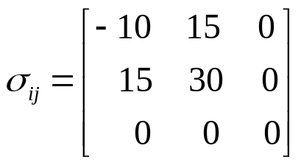
Example 3
Find the principal stresses and the principal stress directions for the given stress tensor:

Slide 22


Octahedral Plane and Stress
Once the principal directions are known, it is then convenient to use the principal axes as the axis of reference.
Hence, substituting the principal stresses for the stress tensor in the Cauchy’s formulas (2.7) and (2.9), the normal and shear stresses have the simple forms:

Slide 23



...(2.26)
...(2.27)
An octahedral plane is a special plane whose normal n_{i} makes equal angles with the three principal axes.
Thus, the normal stress σ_{oct} and shear stress τ_{oct} are given by Eqns. (2.26) and (2.27) in the form:

Slide 24


...(2.28)
...(2.29)
τ_{oct} can also be expressed in terms of the components of a general state of stress
...(2.29)

